Slide 1

Alternative
Supermarkets Data Insights
Team 2
Notes:
Image by freepik

Slide 2


Content
Introduction to the data.
Cleaning Process
Questions to be answered
Data Report and Insights
Notes:
Image by freepik

Slide 3


Data Introduction
"Supermarkets in large, busy cities are growing quickly, and competition is fierce. This dataset comes from a supermarket company and includes sales data from three different branches over three months. It’s well-suited for applying predictive data analytics methods."
https://shorturl.at/IMcFu
Notes:
Image by freepik

Slide 4


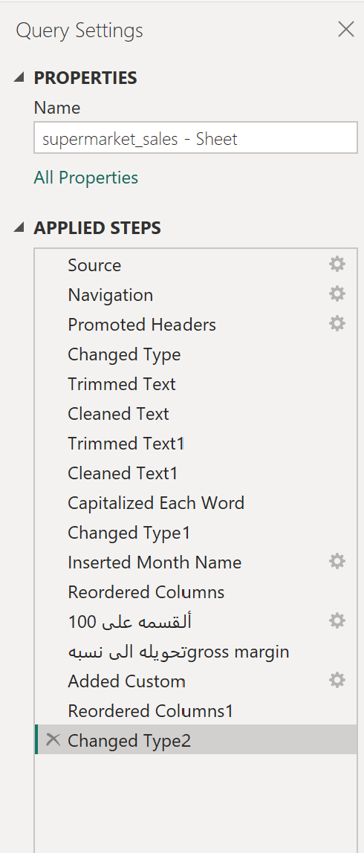
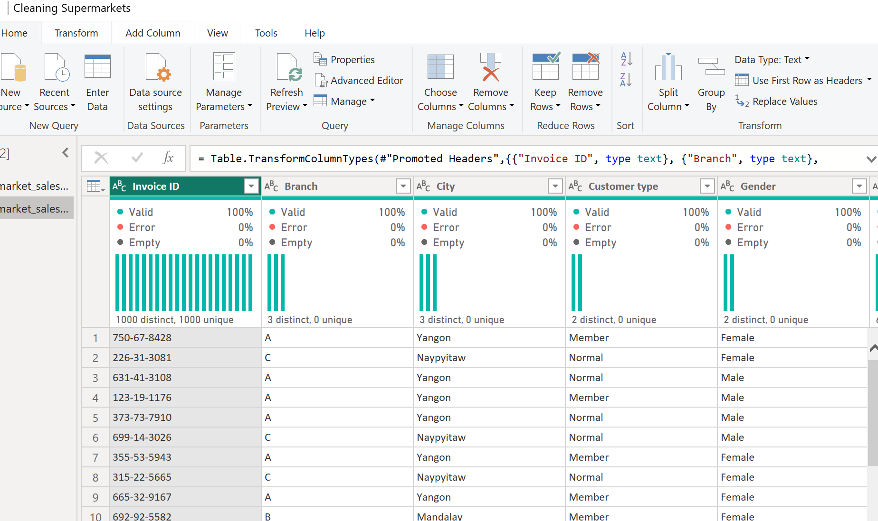
Cleaning Process
Stage 01
Stage 02
Uploading data to Power Query for processing. Trimming, cleaning
Capitalizing each text column in the table.
Optimizing the data type for Date and Time columns.
Adding a Month column extracted from the Date column to identify each month
Separately. Changing the Gross margin percentage data type from number to percentage (%) by dividing by 100.
Adding a Total (excluding tax) column by multiplying Quantity and Unit Price.
Renaming some cleaning steps for easy reference if needed.
Notes:
Image by freepik

Slide 5

Questions To Be Answered
Sales By Gender
Products Sales
We Need to Know the division between both genders in terms of total amount and orders and the frequency by time this will tell us more about both genders' consumer behavior
We need to analyze the products lines sales numbers monitoring the highest and lowest 3 lines will help take actions in the future
Payment Methods
Evaluating COGS VS Sales
Analyzing Payment methods for users also is a very important insight and the items bought using different payments methods
It is Crucial in Retail business too keep a healthy graph compared to COGS this is also in an important insight to check in the data
Notes:
Image by freepik

Slide 6
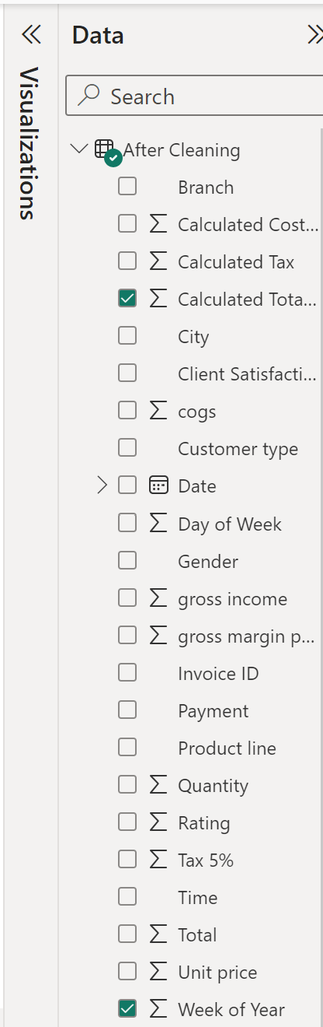
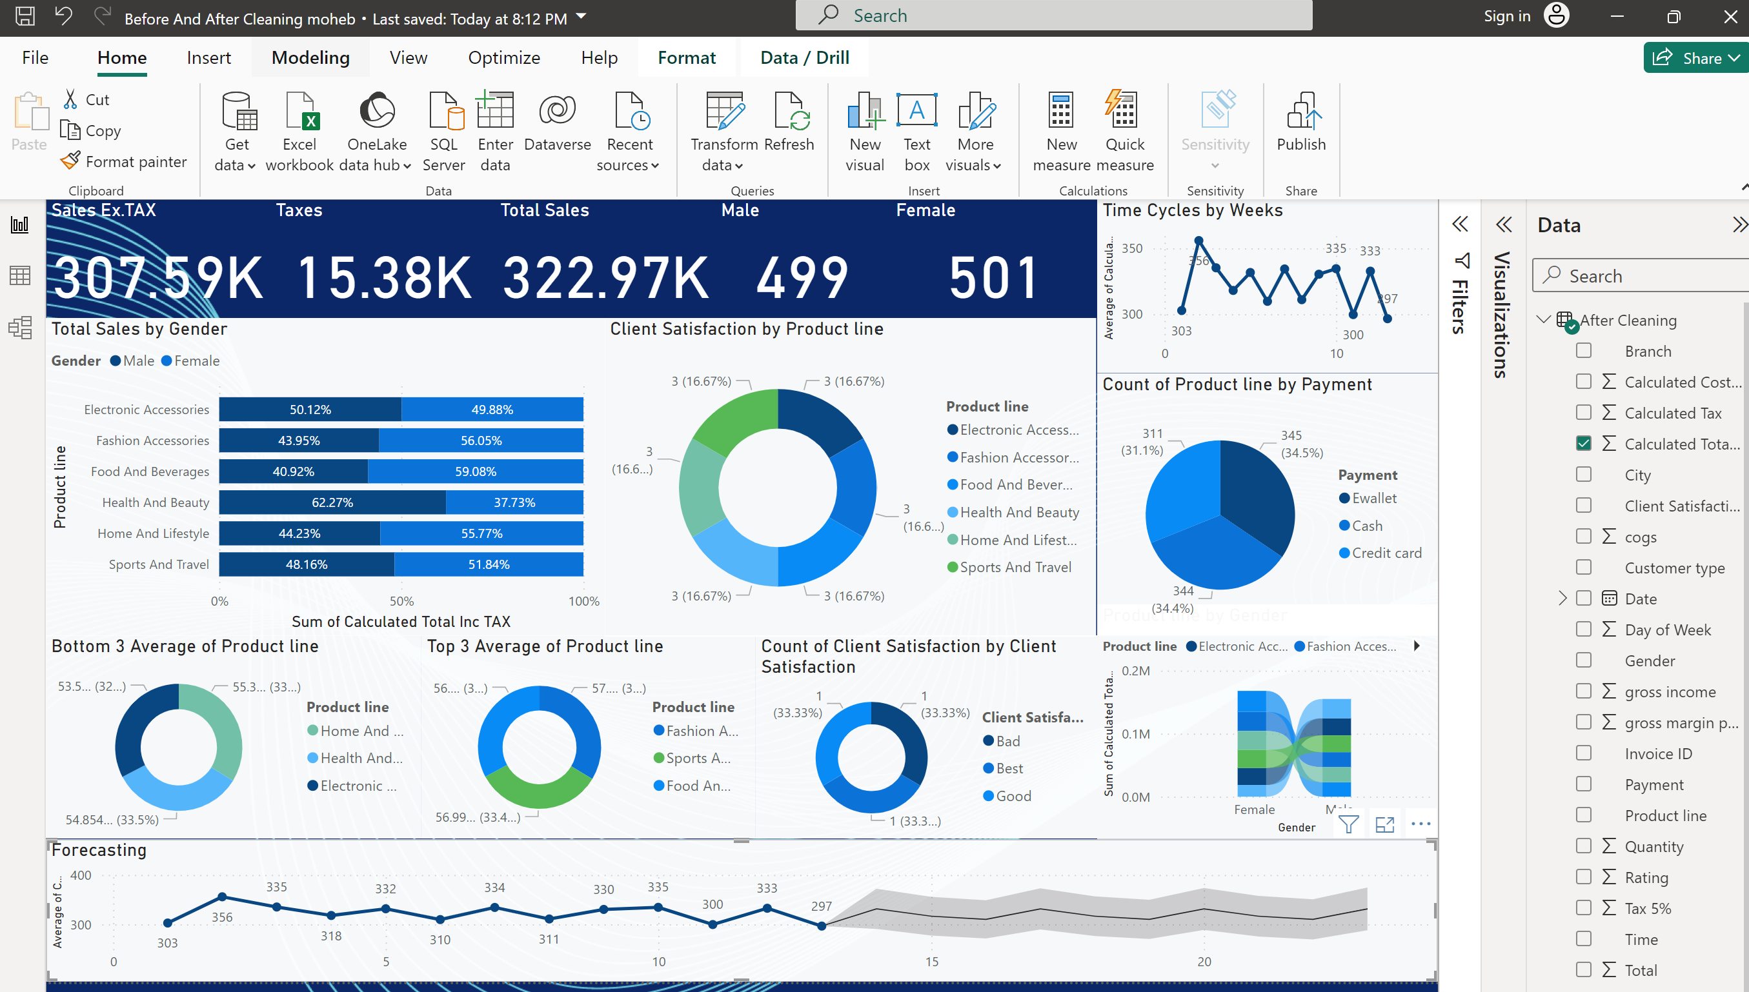
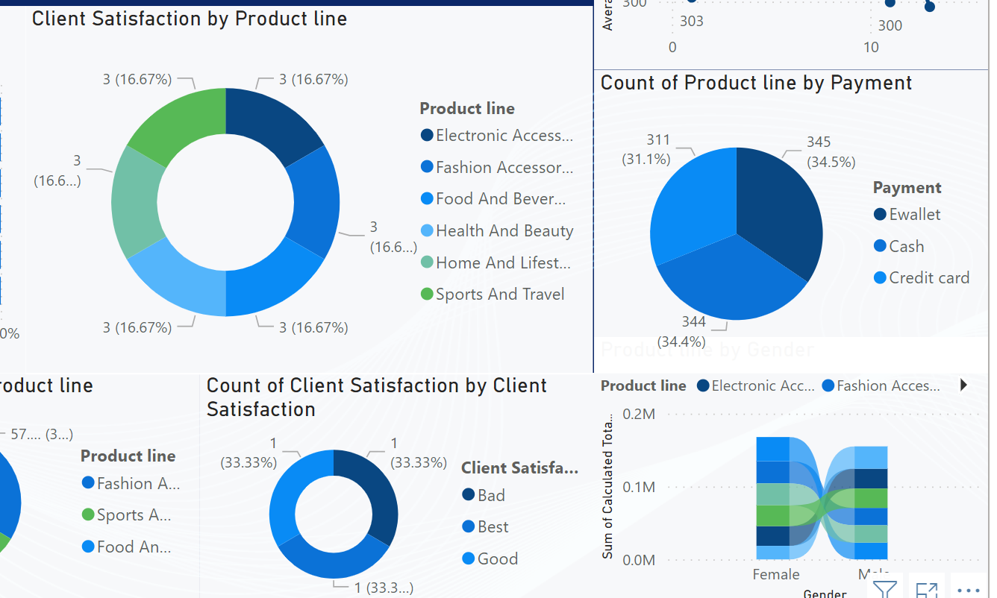
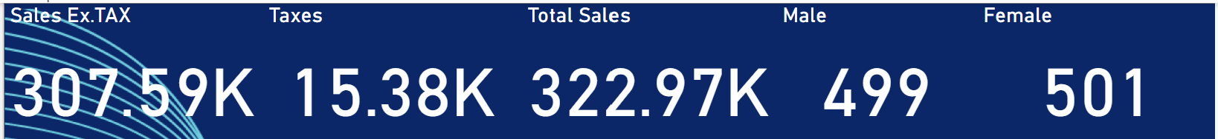
Data Report
PBI Dashboard
SS From the Dashboard and all Insights.
Notes:
Image by freepik

Slide 7
Team Members
Abdelfatah .
Ali
Mahmoud
Moheb
Youssef
Notes:
Image by freepik

Slide 8
Thank You
Notes:
Image by freepik

